Slide 1
Chapter 5
Basic Processing Unit

Slide 2
Processing Unit
A processor is responsible for reading program instructions from the computer’s memory and executing them.
It fetches one instruction at a time.
It decodes (interprets) the instruction.
Then, it carries out the actions specified.

Slide 3
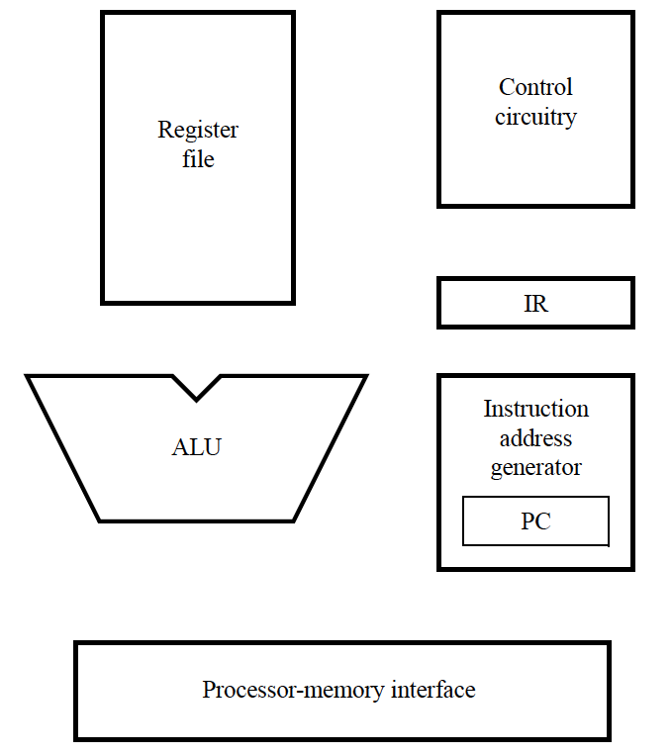
Processor’s building blocks
PC provides instruction address.
Instruction is fetched into IR
Instruction address generator updates PC
Control circuitry interprets instruction and generates control signals to perform the actions needed.

Slide 4
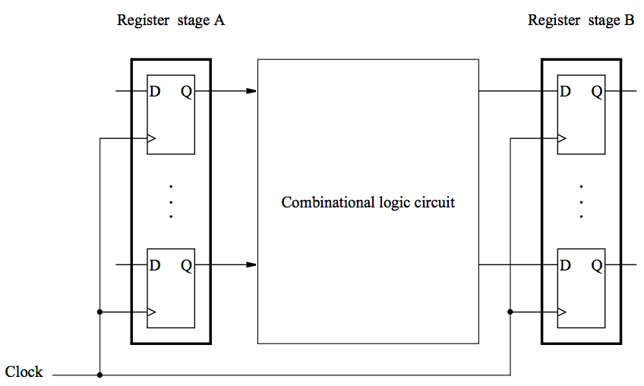
A digital processing system
Contents of register A are processed and deposited in register B.

Slide 5
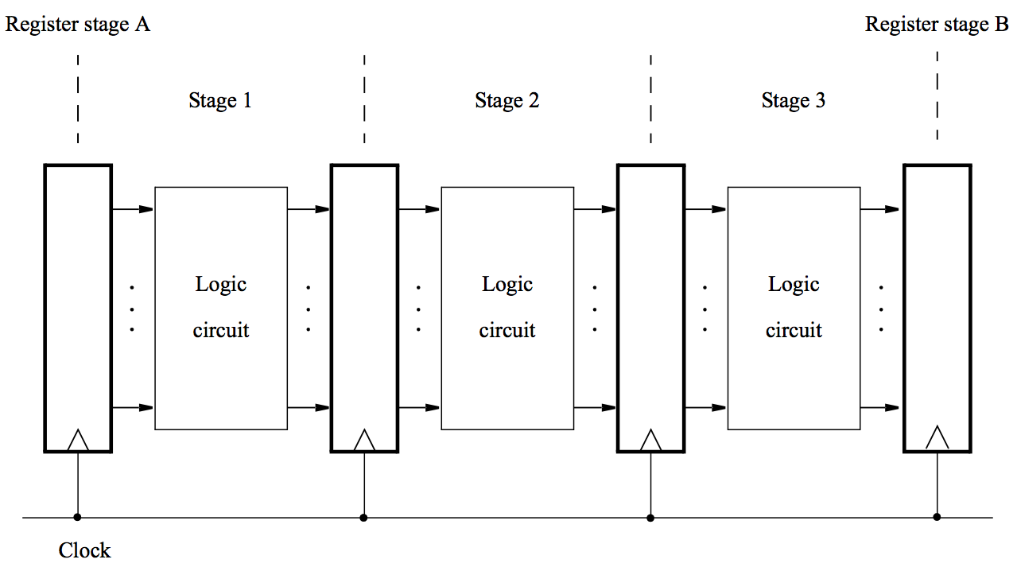
A multi-stage digital processing system

Slide 6
Why multi-stage?
Processing moves from one stage to the next in each clock cycle.
Such a multi-stage system is known as a pipeline.
High-performance processors have a pipelined organization.
Pipelining enables the execution of successive instructions to be overlapped.
Pipelining will be discussed later.

Slide 7
Instruction execution
Pipelined organization is most effective if all instructions can be executed in the same number of steps.
Each step is carried out in a separate hardware stage.
Processor design will be illustrated using five hardware stages.
How can instruction execution be divided into five steps?

Slide 8
A memory access instruction: Load R5, X(R7)
Fetch the instruction and increment the program counter.
Decode the instruction and read the contents of register R7 in the register file.
Compute the effective address.
Read the memory source operand.
Load the operand into the destination register, R5.

Slide 9
A computational instruction: Add R3, R4, R5
Fetch the instruction and increment the program counter.
Decode the instruction and read registers R4 and R5.
Compute the sum [R4] + [R5].
No action.
Load the result into the destination register, R3.
Stage 4 (memory access) is not involved in this instruction.

Slide 10
Summary – Actions to implement an instruction
Fetch an instruction and increment the program counter.
Decode the instruction and read registers from the register ﬁle.
Perform an ALU operation.
Read or write memory data if the instruction involves a memory operand.
Write the result into the destination register.
This sequence determines the hardware stages needed.

Slide 11
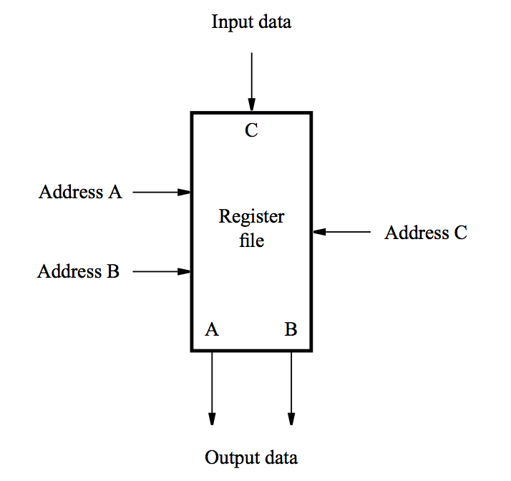
Hardware components: Register file
A 2-port register file is needed to read the two source registers at the same time.
It may be implemented using a 2-port memory.

Slide 12
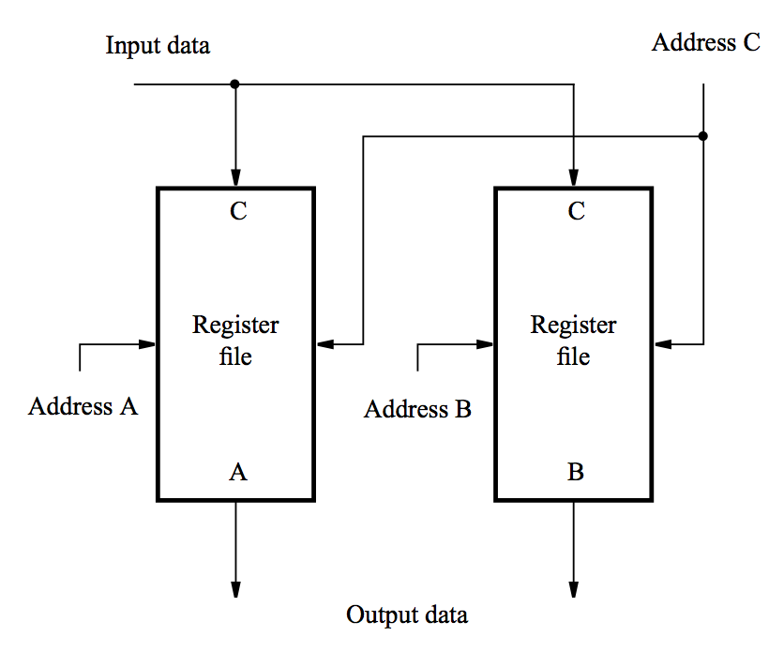
Alternative implementation of 2-port register file
Using two single-ported memory blocks.

Slide 13
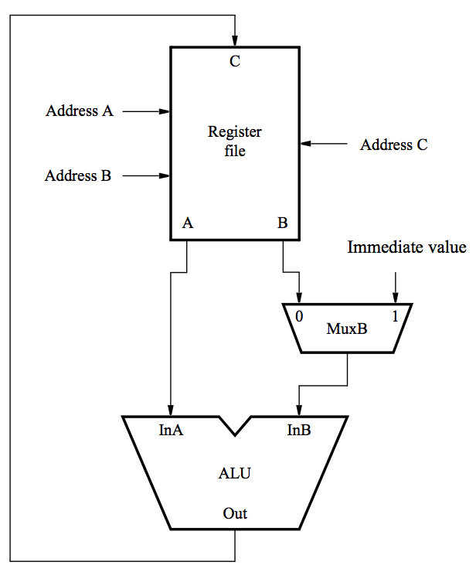
A conceptual view – computational instructions
Both source operands and the destination location are in the register file.
[RA] and [RB] denote values of registers that are identified by
addresses A and B
new [RC] denotes the
result that is stored to
the register identified
by address C
[RB]
new [RC]
[RA]

Slide 14
A conceptual view – immediate instructions
One of the source operands is the immediate value in the IR.
new [RC]
[RA]

Slide 15
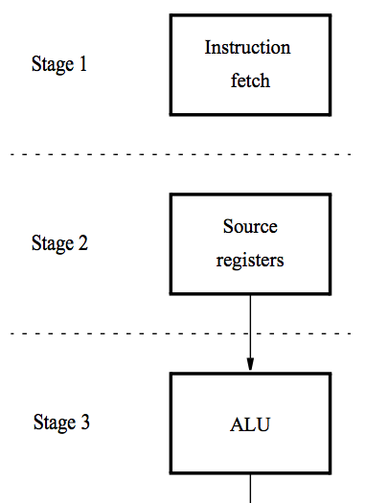
A 5-stage implementation of a RISC processor
Instruction processing moves from stage to stage in every clock cycle, starting with fetch.
The instruction is decoded and the source registers are read in stage 2.
Computation takes place in the ALU in stage 3.

Slide 16
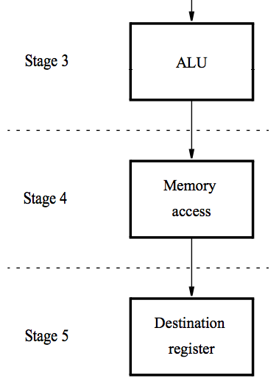
A 5-stage implementation of a RISC processor
If a memory operation is involved, it takes place in stage 4.
The result of the instruction is stored in the destination register in stage 5.

Slide 17
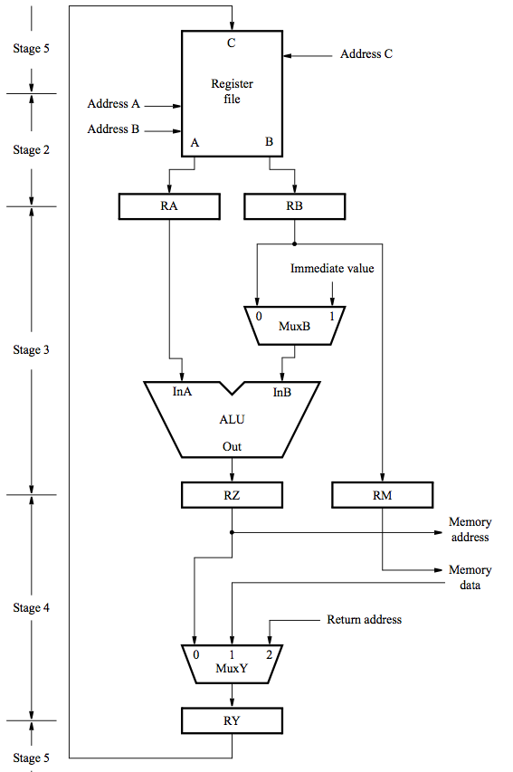
The datapath – Stages 2 to 5
Register file,
used in stages 2 and 5
(Inter-stage registers RA, RB, RZ, RY needed to carry data from one stage to the next.)
ALU stage
Memory stage
Final stage to store result
to the register file

Slide 18
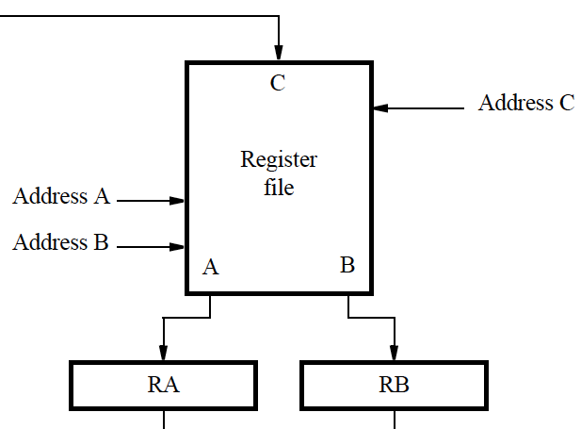
Register file – Stages 2 & 5
Address inputs are connected to the corresponding fields
in IR.
Source registers are read in stage 2; their contents are stored in RA and RB.
In stage 5, the result of the instruction is stored in the destination register selected by address C.

Slide 19
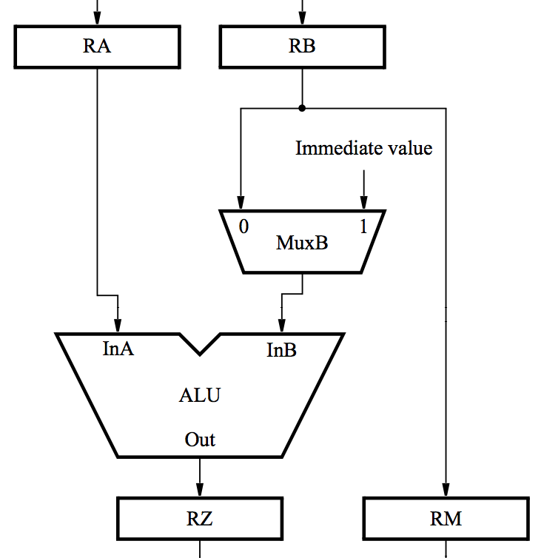
ALU stage
ALU performs calculation specified by the instruction.
Multiplexer MuxB selects either RB or the Immediate field of IR.
Results stored in RZ.
Data to be written in the memory are transferred from RB to RM.

Slide 20
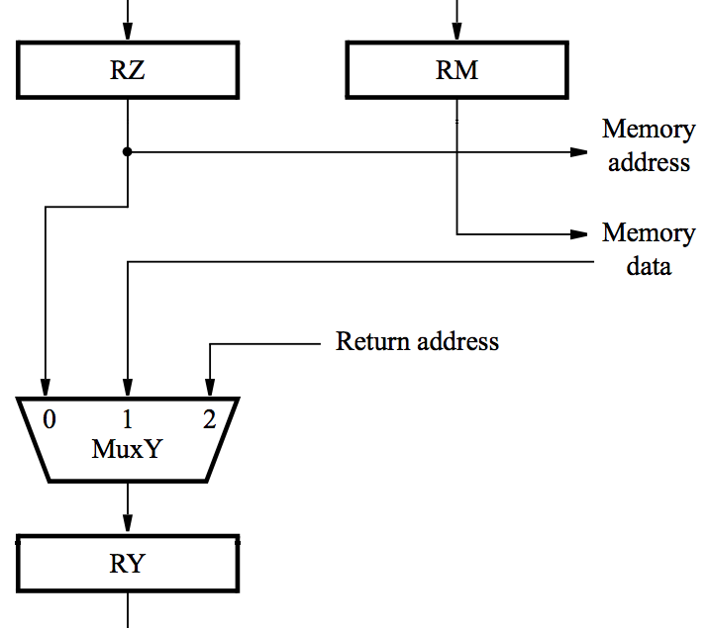
Memory stage
For a memory instruction, RZ provides memory address, and MuxY selects read data to be placed in RY.
RM provides data for a memory write operation.
For a calculation instruction, MuxY selects [RZ] to be placed in RY.
Input 2 of MuxY is used in subroutine calls.

Slide 21
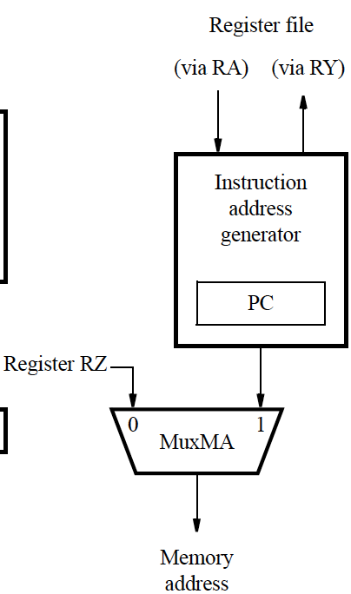
Memory address generation
MuxMA selects the PC when fetching instructions.
The Instruction address generator increments the PC after fetching an instruction.
It also generates branch and subroutine addresses.
MuxMA selects RZ when reading/writing data operands.

Slide 22
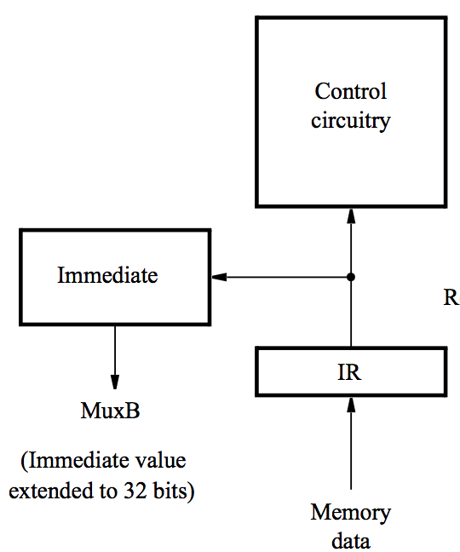
Processor control section
When an instruction is read, it is placed in IR.
The control circuitry decodes the instruction.
It generates the control signals that drive all units.
The Immediate block extends the immediate operand to 32 bits, according to the type of instruction.

Slide 23
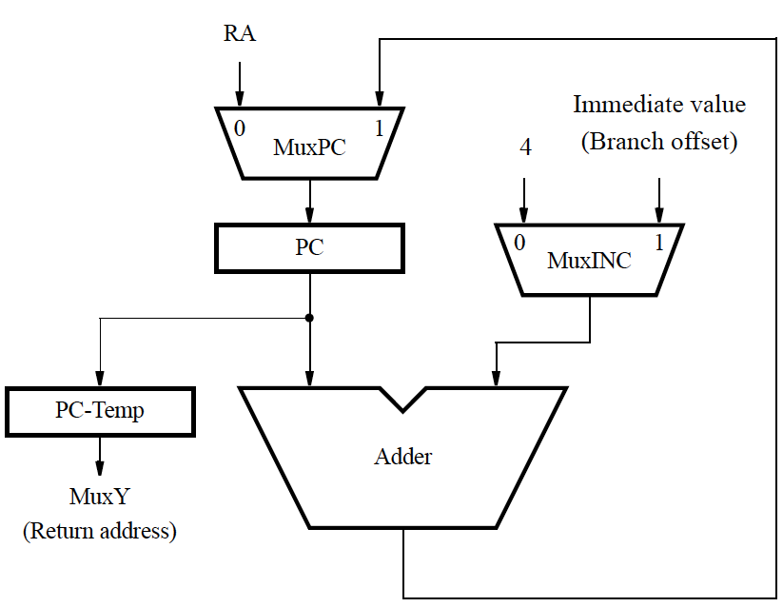
Instruction address generator
Connections to registers RY and RA are used to support subroutine call and return instructions.

Slide 24
Example: Add R3, R4, R5
Memory address ← [PC], Read memory, IR ←Memory data, PC ← [PC] + 4
Decode instruction,
RA ← [R4], RB ← [R5]
RZ ← [RA] + [RB]
RY ← [RZ]
R3 ← [RY]

Slide 25
Example: Load R5, X(R7)
Memory address ← [PC],
Read memory, IR ← Memory data, PC ←[PC] + 4
Decode instruction, RA ←[R7]
RZ ←[RA] + Immediate value X
Memory address ←[RZ], Read memory, RY ← Memory data
R5 ←[RY]

Slide 26
Example: Store R6, X(R8)
Memory address ←[PC], Read memory, IR ← Memory data, PC ← [PC] + 4
Decode instruction,
RA ←[R8], RB ←[R6]
RZ ←[RA] + Immediate value X, RM ←[RB]
Memory address ←[RZ], Memory data ←[RM], Write memory
No action

Slide 27
Unconditional branch
Memory address ←[PC], Read memory, IR ← Memory data, PC ←[PC] + 4
Decode instruction
PC ←[PC] + Branch offset
No action
No action

Slide 28
Conditional branch: Branch_if_[R5]=[R6] LOOP
Memory address ←[PC], Read memory, IR ← Memory data, PC ←[PC] + 4
Decode instruction, RA ←[R5], RB ←[R6]
Compare [RA] to [RB],
If [RA] = [RB], then PC ←[PC] + Branch offset
No action
No action

Slide 29
Subroutine call with indirection: Call_register R9
Memory address ←[PC], Read memory, IR ← Memory data, PC ←[PC] + 4
Decode instruction, RA ←[R9]
PC-Temp ←[PC], PC ←[RA]
RY ← [PC-Temp]
Register LINK ← [RY]

Slide 30
Control signals
Select multiplexer inputs to guide the flow of data.
Set the function performed by the ALU.
Determine when data are written into the PC, the IR,
the register file, and the memory.
Inter-stage registers are always enabled because
their contents are only relevant in the cycles for which
the stages connected to the register outputs are active.

Slide 31
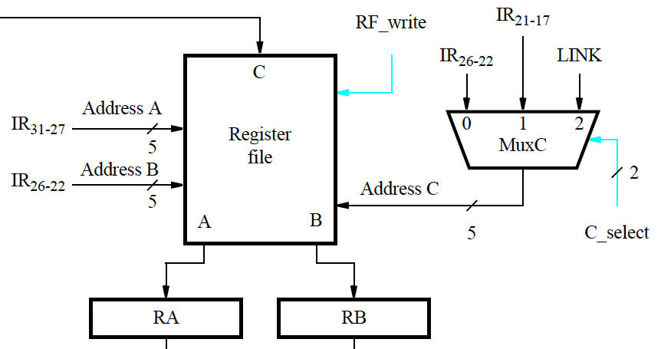
Register file control signals

Slide 32
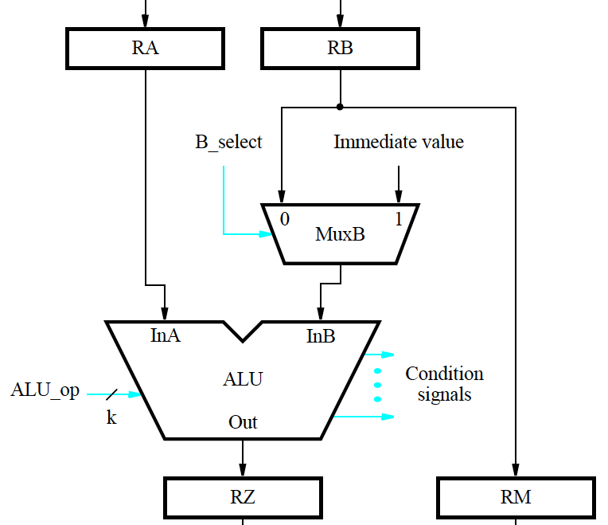
ALU control signals

Slide 33
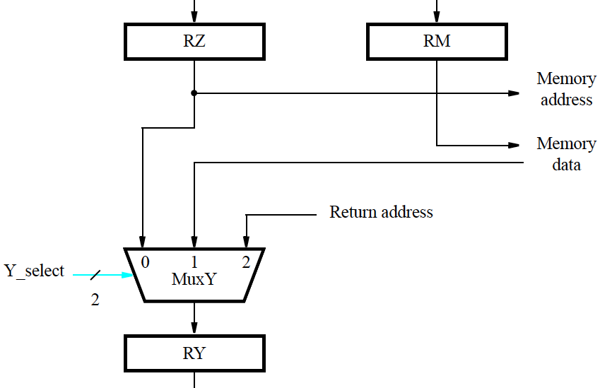
Result selection

Slide 34
Memory access
Cache memory described earlier as faster and smaller storage that is an adjunct to the larger and slower main memory.
When data are found in the cache, access to memory can be completed in one clock cycle.
Otherwise, read and write operations may require several clock cycles to load data from main memory into the cache.
A control signal is needed to indicate that memory function has been completed (MFC). E.g., for step 1:
Memory address ← [PC], Read memory, Wait for MFC,
IR ← Memory data, PC ←[PC] + 4

Slide 35
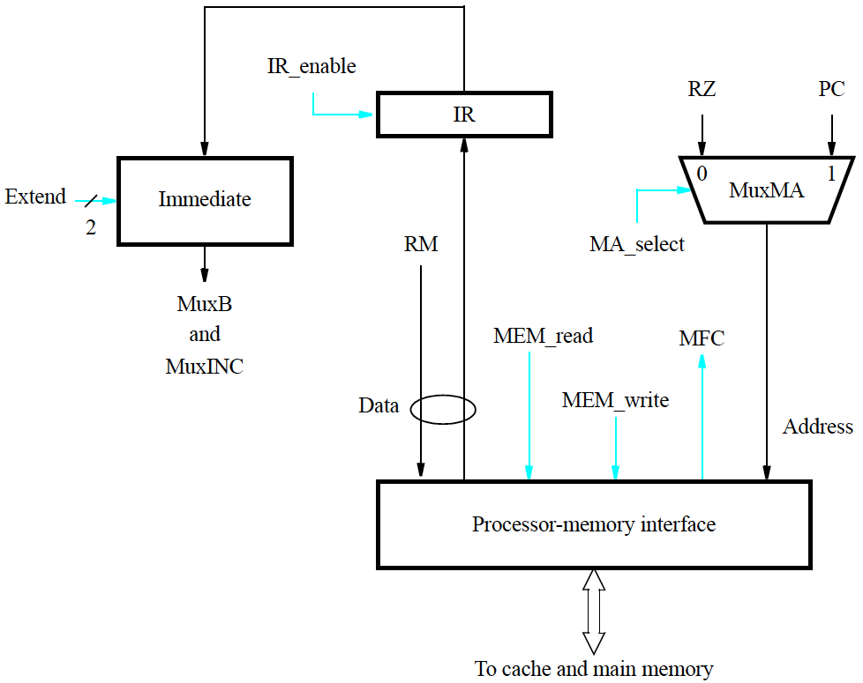
Memory and IR control signals

Slide 36
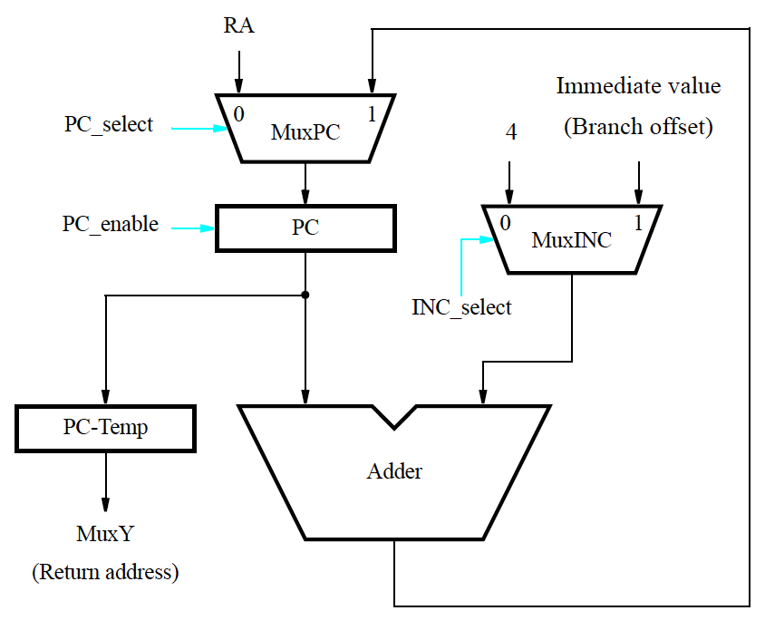
Control signals of instruction address generator

Slide 37
Control signal generation
Actions to fetch & execute instructions have been described.
The necessary control signals have also been described.
Circuitry must be implemented to generate control signals
so actions take place in correct sequence and at correct time.
There are two basic approaches:
hardwired control and microprogramming
Hardwired control involves implementing circuitry that
considers step counter, IR, ALU result, and external inputs.
Step counter keeps track of execution progress,
one clock cycle for each of the five steps described earlier
(unless a memory access takes longer than one cycle).

Slide 38
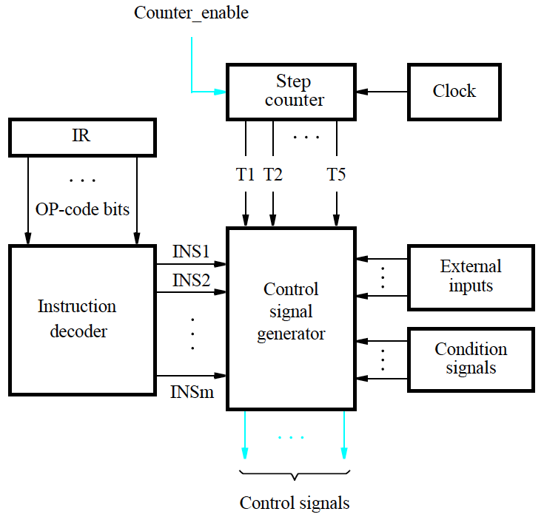
Hardwired generation of control signals

Slide 39
CISC processors
CISC-style processors have more complex instructions.
The full collection of instructions cannot all be implemented in a fixed number of steps.
Execution steps for different instructions do not all follow
a prescribed sequence of actions.
Hardware organization should therefore enable
a flexible flow of data and actions to accommodate CISC.

Slide 40
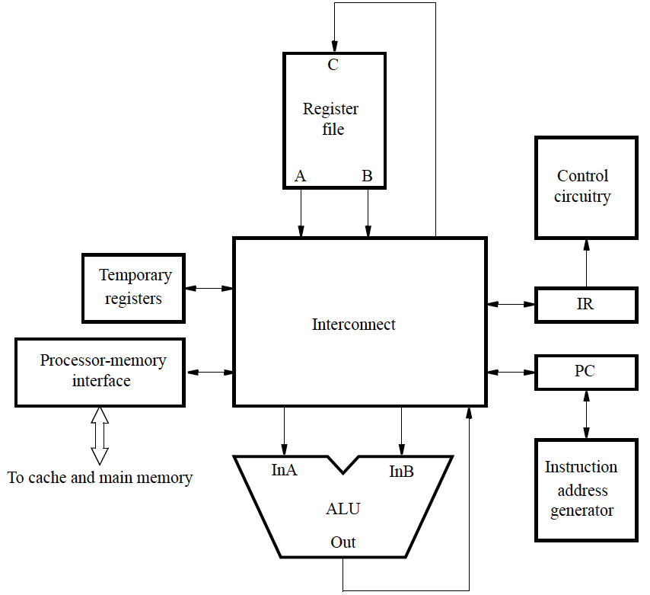
Hardware organization for a CISC computer

Slide 41
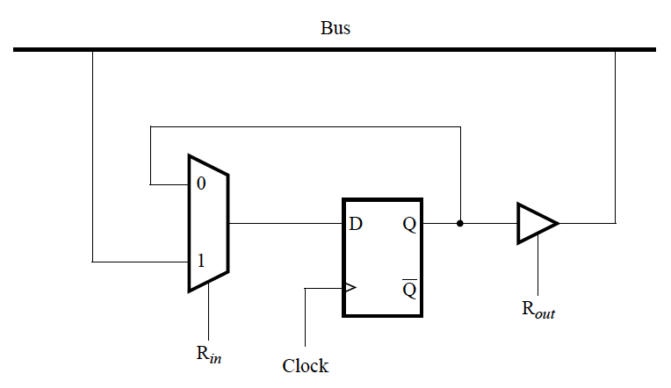
Bus
An example of an interconnection network.
When functional units are connected to a common bus,
tri-state drivers are needed.

Slide 42
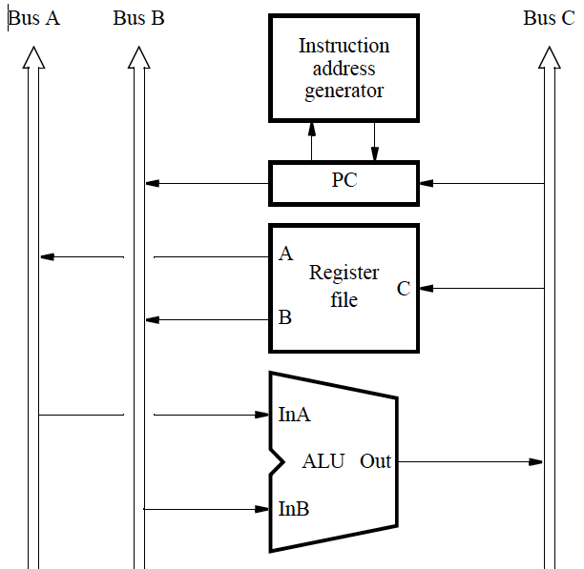
A 3-bus interconnection network

Slide 43
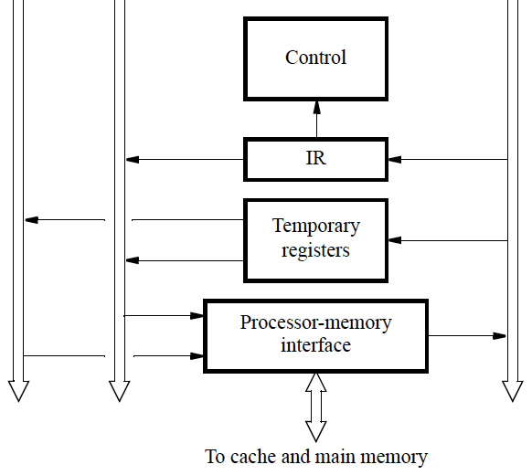
A 3-bus interconnection network

Slide 44
Example: Add R5, R6
Memory address ←[PC], Read memory, Wait for MFC,
IR ← Memory data, PC ←[PC] + 4
Decode instruction
R5 ←[R5] + [R6]

Slide 45
Example: And X(R7), R9
Memory address ←[PC], Read memory, Wait for MFC,
IR ← Memory data, PC ←[PC] + 4
Decode instruction
Memory address ←[PC], Read memory, Wait for MFC,
Temp1 ← Memory data, PC ←[PC] + 4
Temp2 ←[Temp1] + [R7]
Memory address ←[Temp2], Read memory, Wait for MFC, Temp1 ← Memory data
Temp1 ←[Temp1] AND [R9]
Memory address ←[Temp2], Memory data ←[Temp1],
Write memory, Wait for MFC

Slide 46
Microprogramming
Microprogramming is a software-based approach
for the generation of control signals.
The values of the control signals for each clock period are stored in a microinstruction (control word).
A processor instruction is implemented by a sequence of microinstructions that are placed in a control store.
From decoding of an instruction in IR, the control circuitry executes the corresponding sequence of microinstructions.
μPC maintains the location of the current microinstruction.

Slide 47
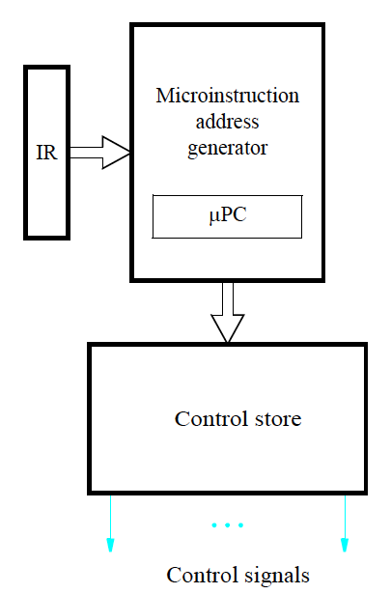
Control signals generated from a microprogram

Slide 48
Microprogramming
Microprogramming provides the flexibility needed
to implement more complex instructions in CISC processors.
However, reading and executing microinstructions incurs undesirably long delays in high-performance processors.

